Slide 1

Team Project Proposal
Generate Captions of Images
In Your Documents
Service Oriented Computing
2019 Vu Anh Van
20194334 Soyeon Kim

Slide 2
Contents
Part 1
Motivation
Part 2
Proposed Idea
Part 3
Overall Architecture
Part 4
Model description
Part 5
Results and Demo

Slide 3
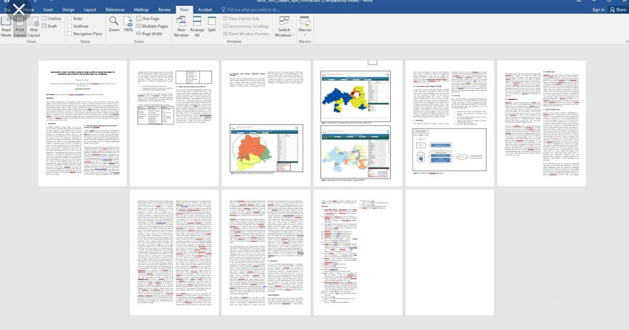
Motivation
Background
Usually we put multiple images in our documents
Tedious works to write each caption of each images in documents
What about a service that generates captions automatically?

Slide 4
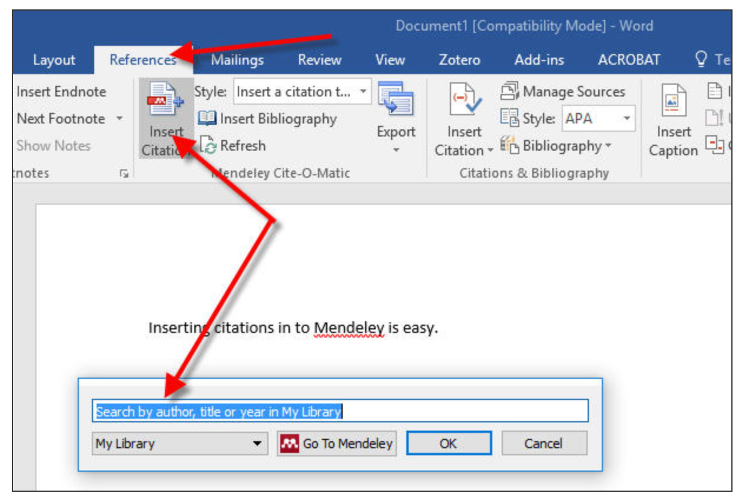
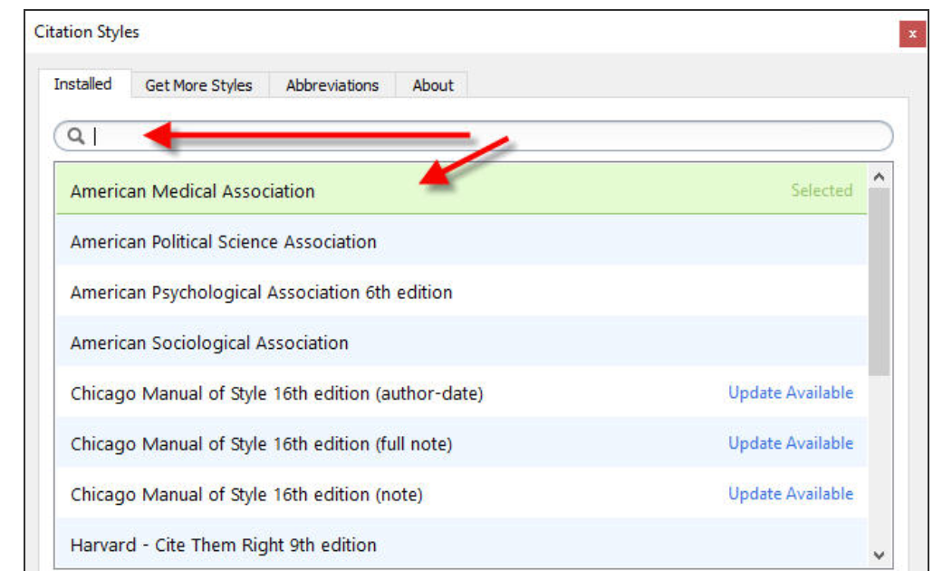
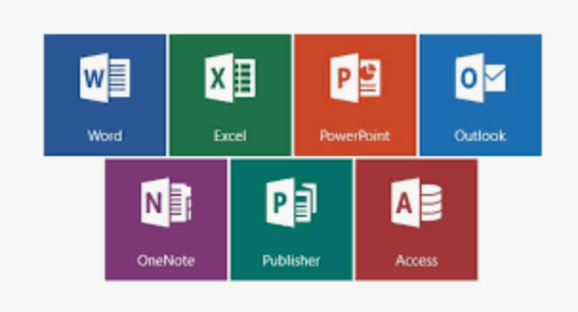

Proposed Idea
Benchmark service
There are kinds of services that generate a certain format of citation for papers
Ex. Mendeley
Generate proper captions for images in documents automatically
Image captioning: automatically generating a natural language description of an image.
Captions are usually related to the not only images but also the sentences in the documents → computer vision & NLP
Make a prototype as a web service
The service integrated this function would be nice with Microsoft office and so on
But, first we’ll make a prototype as a web service

Slide 5
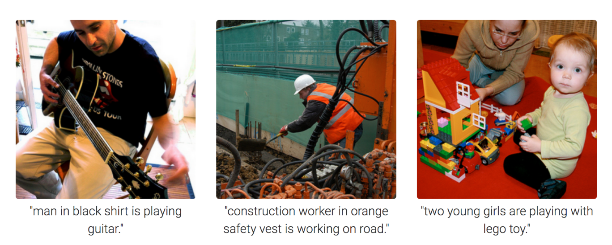
Proposed Idea
Generate proper captions for images in documents
Image captioning
automatically generating a natural language description of an image
Very related to computer vision and natural langue processing

Slide 6
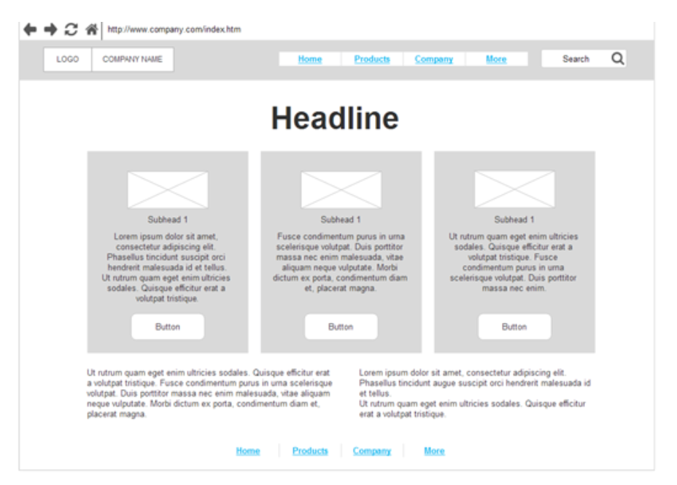

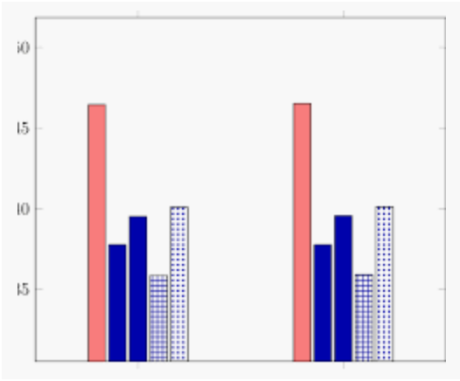
Proposed Idea
Simple draft of a service look
Make captions
uploaded
Work!
Download
upload docs.
Ex. Pdf
2. Show the performance
Ex. CIDEr performance per image
3. After learning, the result file is available to download

Slide 7
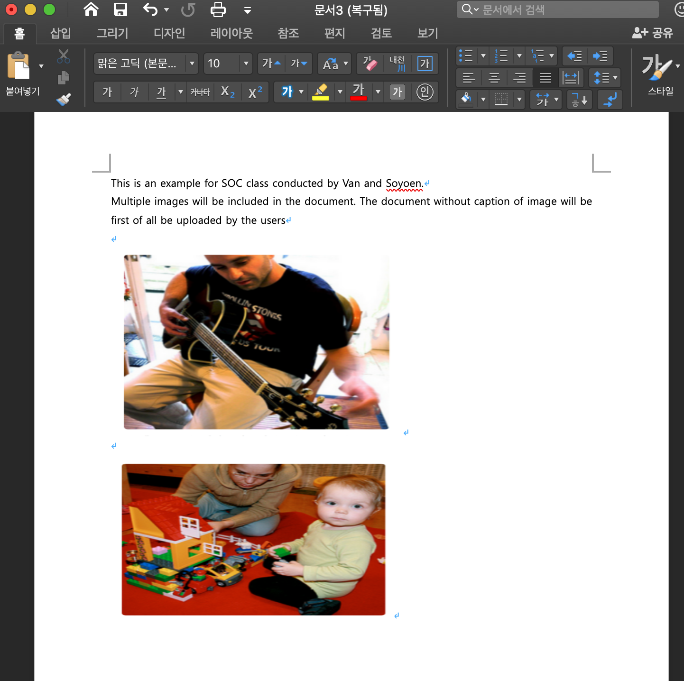
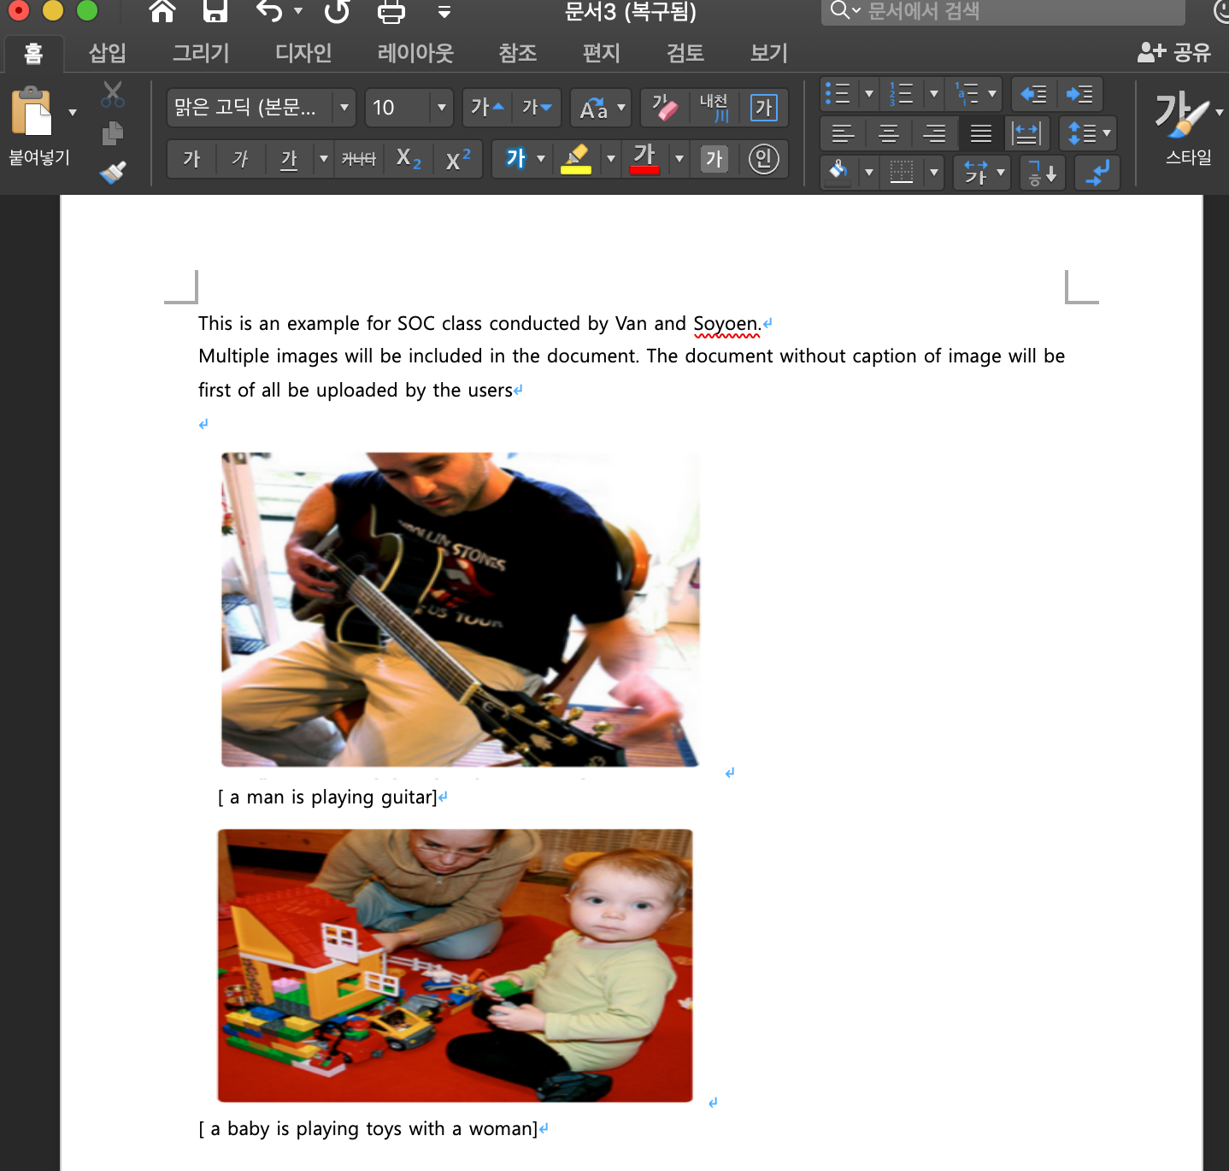
Proposed Idea
If upload the file, the expected results are …

Slide 8

Overall Architecture
Overall Service Architecture
Frontend
UI Component with React
Flask RESTful API using HTTP
Docx file upload
POST, GET, PUT, PATCH, DELETE
New docx file to be downloaded
Backend
Extract images from docx
Model
prediction
Generate new file
Import a base model from keras
Train modified model for image caption
Put captions

Slide 9
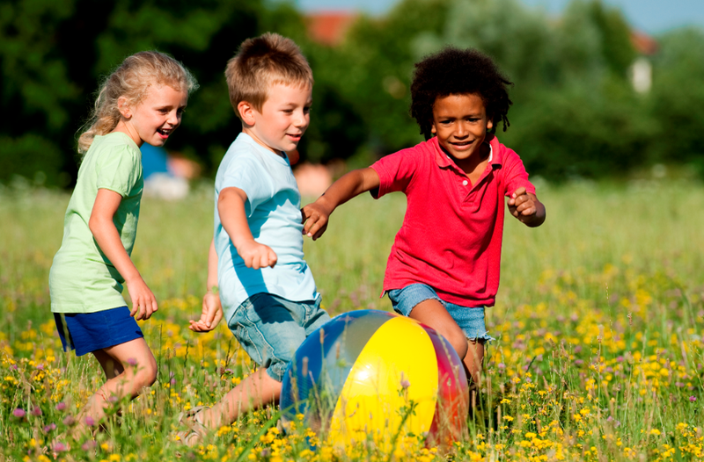
Model description
Overall Deep learning model Architecture
predicting
reshape
Base model:
Inception V3
Feature vectors
(= representation)
dropout
ReLU
ReLU
Vocab embedding
softmax
Preprocessing captions
dropout
Probability distribution of possible words
LSTM
Embedding context vectors
training+testing
Iterate until the sentence ends
Choose max values
greedySearch
inputs
final outputs
[ “startseq”]
[ “three children are playing”]

Slide 10
Model description
Training model summary
Training/test dataset: Flickr8k
Images with 5 different possible captions
Training: 6000 , test: 1000
2 main deep learning models
Convolutional Neural Network(CNN): to catch overall feature of images
Long Short Term Memory(LSTM): to produce full sentences based on the prediction using each part of images and which words it produced so far
Loss function: crossentropy
Optimizer: Adam
Learning rate=0.001
Epochs=10
CPU
Web deployment & frameworks
Flask, React.js
Keras
Expected Results & Performance analysis(until next week)
BLEU score for texts which seem plausible
Loss

Slide 11
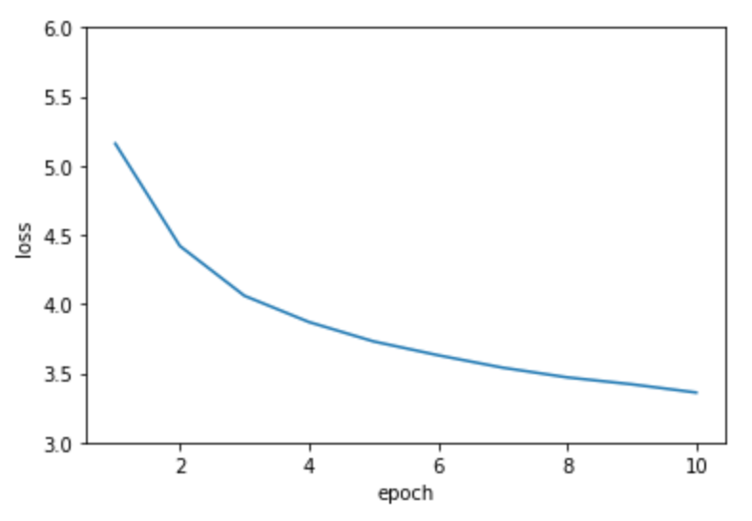
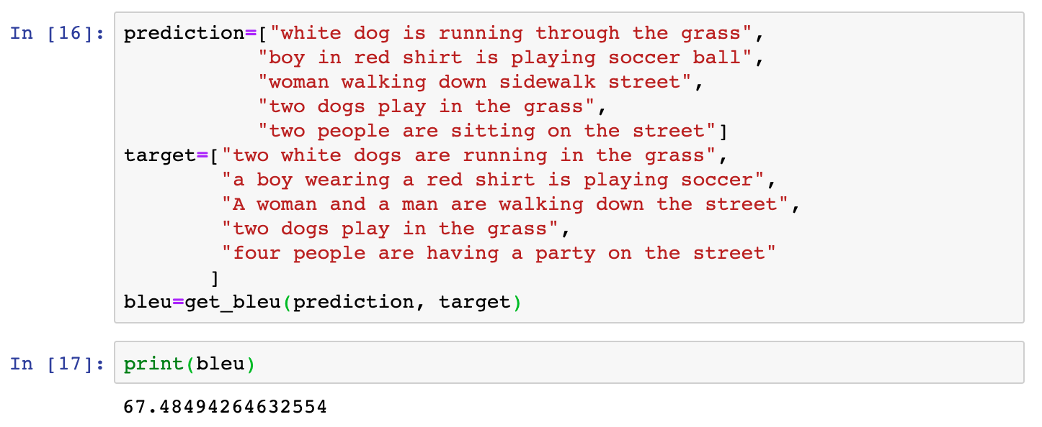
Results
Performance: loss
End loss: 3.3674
BLEU score: an algorithm for evaluating the quality of text which has been machine translated
Average BLEU score: 67.49
Notes:
Loss for the difference between original embedding vectors and generated captions are measured per batch
Better to use CIDEr: consensus based image description

Slide 12
Results
Demo!

Slide 13
Thank you

